Slide 1

1066 Claimants for the throne of England

Slide 2
Curriculum Links
Significant historical events, people and places in their own locality.
A study of an aspect or theme in British history that extends pupils’ chronological knowledge beyond 1066.
Learning Goals
At the end of the lesson students will have an understanding of what makes a good medieval king. They will have been introduced to the Claimants for the throne in 1066 and the source of each claim. They will also have the beginnings of an understanding of historical bias.

Slide 3
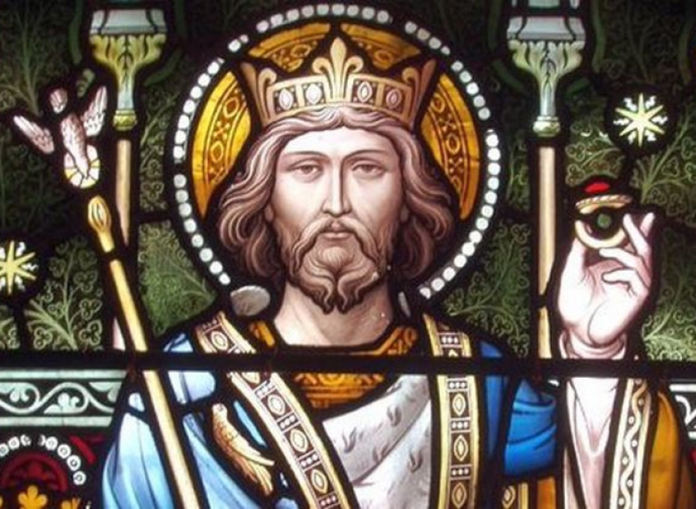
The Death Of Edward The Confessor
In January 1066 King Edward the Confessor died at the age of 61. He had ruled England for more that 24 years.
Traditionally Edward has been seen by historians as, not the most dynamic of Kings.
He has often been regarded, as he is portrayed on the Bayeux tapestry, a weak old man; whose indecision sparked the crisis in 1066, that was to become the Norman Conquest of England
However modern historians challenge this view.
Rather than being a weak indecisive king, constantly at prayer, we are beginning to see a rightful Monarch, descended from Alfred the Great, who fought for his crown and, whose policies kept England safe for 24 years.
Notes:
The traditional weak view od Edward as a weak pious king uninterested in the worldly affairs of Kingship comes from many sources most of which are unreliable. Tom Licence, professor of Medieval Studies at the University of East Anglia, suggests that it was Edward himself or his courteous who fostered this image of a holy king who worked miracles in an effort to boost his mystique. Being seen as a man close to God would have been a very appealing image for a medieval king. Later Medieval monks seized upon the image and claimed Edward as one of their own. He was sanctified as a saint who confessed the Christian faith by his actions. It was however the Victorians who Popularised the, now somewhat traditional, view of St Edward the Confessor. Victorian society tended to have a rather romantic view of history and they loved their heroes. The Saintly Edward, who gave rise to the Brave Harold; who died to save his Kingdom.

Slide 4
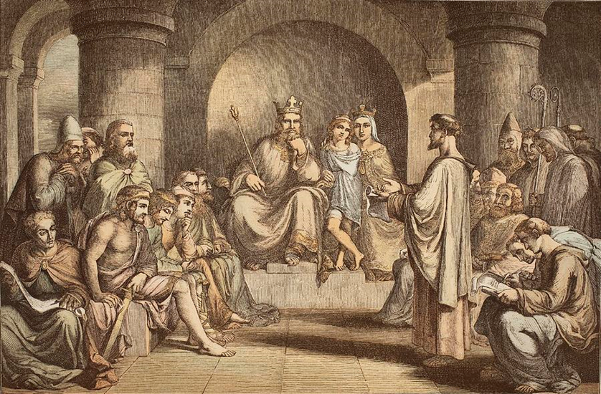
Friend of Normans
Edward was crowned in 1043, but he would have been King much earlier, were it not for the Invasion of England by the Viking King Cnut in 1016, which had forced Edward to flee to Normandy.
During the 25 years that he spent in Normandy, Edward built alliances with the Normans, who recognised his rightful claim to the English throne. With the help and support of Robert Duke of Normandy Edward made several attempts to return to England. Finally succeeding in 1041 when he gained Saxon support and was welcomed into the government.
A year later, with the death of Canute’s son, Harthacnut, and with the support of the powerful Earl Godwine, Edward was proclaimed King of England.
Notes:
Cnut would almost certainly have executed Edward if he had stayed in England. Edward was related to Robert Duke of Normandy, through his Mother, Emma of Normandy, who was also Robert’s great aunt. There are a number of Norman charters, dating back as far as 1034, which name Edward as King of England so it is clear that he had strong Norman support. Allied with Duke Robert , Edward attempted to invade Cnut’s England but the fleet was blown off course. A second attempted invasion in 1036 also failed due to lack of political support in England. Finally in 1041 Cnut’s son Harthacnut invited Edward back to England. Some sources suggest that he was his intended heir. After Harthacnut’s death in 1042, Edward was proclaimed King. His main supporter was the Earl Godwin whose power and influence extended as far back as Cnut.

Slide 5
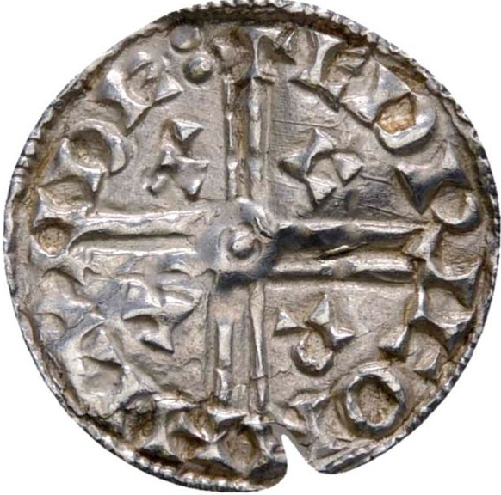
Peace Through Strength
Edward’ central policy was one of peace, he even had a coined minted soon after his coronation with the word PACX (peace) embossed upon it.
As with his illustrious ancestor Alfred the Great, Edward recognised that in 11th century Europe, peace came through strength and unity.
Edward, believed that control of the seaways was the key to lasting peace and ordered the building of a huge fleet of ships, to act as a military deterrent. He also ordered the construction of fortified ports at the towns of Sandwich, Dover, Romney, Hastings and Hythe. These became known as the cinque ports
Notes:
Edwards inaugeral coin was the first in English history to carry the word peace. The word pacx can be seen inside the cross on the coin. In the time of Alfred the biggest threat to England had been the Vikings, he had protected his borders and strategic towns by building a series of fortified settlements known as Burhs. Edward saw his main threat coming from across the see and ordered the construction of what some sources say was the biggest fleet ever constructed. The maritime institution of the cinque ports is seen by some as the birthplace of the English Navy. For more than 500 years after it’s creation the cinque ports met the military and transportation needs of the kings of England, up until the reign of HenryVIII who began to put in institutions such as the Navy board and the office of the Amiralty, which formed the base of the Royal Navy.

Slide 6
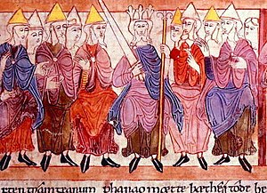
A King Needs Support
Throughout history no king has been able to rule effectively without the support of the most powerful lords in his kingdom.
Edward had spent the majority of his life in Normandy prior to becoming king. Whilst he had many allies in Normandy, he had Not had the opportunity to form any such alliances with the Saxon Lords of England
He realised on his return to England that he had to get the key nobles in the country on his side. The three most important were, Leofric of Mercia, Godwin, Earl of Wessex and Siward of Northumbria.
Notes:
After so long in Normandy Edward needed to build his powerbase In England, He needed the three most powerful Earls on his size both for their influence on the Kings witan and for their military strength. Leofric of Mercia, whose army along with that of Siward,, supported Edward against Godwin, after the Earls refusal to support the king against the Dover mob who had attacked a Norman delegation in 1051, Also brockered a deal with the Witan, whose intervention released the tensions between the King and Earl Godwin and took away the threat of conflict and potential civil war. It was the Witan who stepped in and voted to banish Godwine. Leofric was a very useful man to have on the Kings side Unfortunately for Earl Leofric popular History tends to side-line him in favour of his more famous wife, Lady Godiva.
Earl Siward was a powerful Northern warlord, whose Earldom of Southern Northumbria (modern day Yorkshire) was one of the largest in the kingdom. He was of Scandinavian origin and had risen to power through his support of the Viking Kings Cnut and Harthacnut. Such was his power that by the time Edward came to the throne Siward had effective control of most of Northern England. In Game of Thrones parlance, he would be seen as the King in the North. His power in the North helped to brocker peace with Scotland. His most famous military success is likely to be his defeat of the Scottish King Mac Bethad mac Findlaích, better known as Macbeth. Both Edward the Confessor and Siward are named in Shakespeare’s play of the same name.

Slide 7
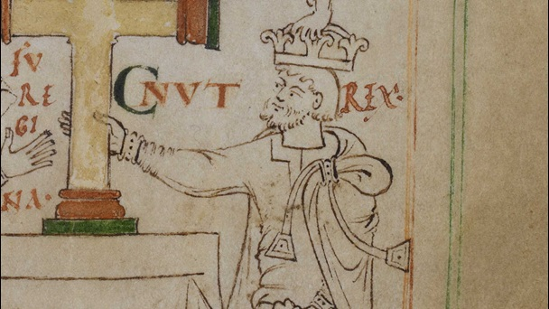
Godwine
The mightiest of all the Lords of England under Edward the confessor was Godwine Earl of Wessex.
Godwine had the power of a Kingmaker. He had been the right hand man of King Cnut, and his support had been crucial in securing the throne for Cnut’s son, Harthacnut.
Edward needed Godwine on his side.
Winning the allegiance of a lord such as Godwine required gifts and concession. This included a marriage alliance between Godwine’s daughter, Edith, and Edward himself.
Notes:
(Image King Cnut, the first Viking King of England)
The power of lords can often rival that of the king himself. Such was the power of Godwine that Edward would not have succeeded in securing the throne without his support. He was viewed by some Anglo Saxon chronicles as a deceitful Earl intent on his own power. He certainly appears to have aligned his cause to whichever king he felt could ensure his own rise to power. He first came to the fore under king Cnut, rising to become one of his chief advisors. After Cnut’s death, Godwine through his weight behind the claim of Cnut’s son Harold Harefoot against that of Edward the Confessor’s brother, Alfred the Aetheling, Whom he betrayed and had blinded. The Anglos Saxon Chronicle, often so terse and economical with it’s detail, paints a vivid picture of this betrayal.
'As Alfred and his men approached the town of Guildford in Surrey, thirty miles south-west of London, they were met by the powerful Earl Godwin of Wessex, who professed loyalty to the young prince and procured lodgings for him and his men in the town. The next morning, Godwin said to Alfred: "I will safely and securely conduct you to London, where the great men of the kingdom are awaiting your coming, that they may raise you to the throne." This he said in spite of the fact that the throne was already occupied by the son of Knud, Harold Harefoot, and he was actually in league with King Harold to lure the young prince to his death. Then the earl led the prince and his men over the hill of Guildown, which is to the west of Guildford, on the road to Winchester, not London. Perhaps the prince had insisted on continuing his journey to his original destination, his mother's court in Winchester, in any case, Godwin repeated his tempting offer; showing the prince the magnificent panorama from the hill both to the north and to the south, he said: "Look around on the right hand and on the left, and behold what a realm will be subject to your dominion." Alfred then gave thanks to God and promised that if he should ever be crowned king, he would institute such laws as would be pleasing and acceptable to God and men. At that moment, however, he was seized and bound together with all his men. Nine tenths of them were then murdered. And since the remaining tenth was still so numerous, they, too, were decimated. Alfred was tied to a horse and then conveyed by boat to the monastery of Ely. As the boat reached land, his eyes were put out. For a while he was looked after by the monks, who were fond of him, but soon after he died, probably on February 5, 1036.

Slide 8
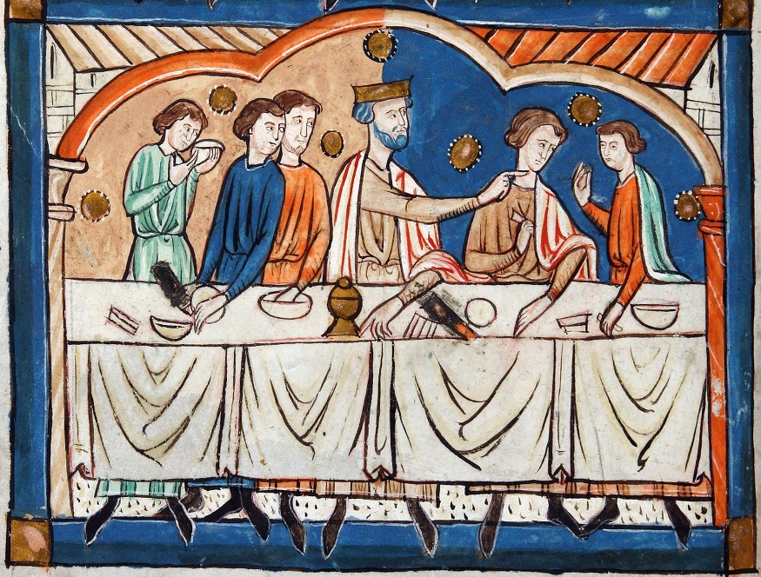
A Challenge to Power
Godwine’s power was such that Edward could not ignore him even though Godwine had betrayed and blinded Edward’s brother Alfred only a few years earlier. Alfred died soon after.
Godwine’s influence with the king began to dimish, as Edward invited French and Norman allies to join his council as advisors.
In 1051 the King invited a friend and ally Count Eustace of Boulogne to England. Eustace and his comrades were attacked by a mob in Dover
Edward sent Godwin to Dover to punish the people there, but Godwine refused and, instead, sided with the Mob against the French and his own King. As a result the kings ruling council, known as the Witan banished. Him and his whole family, Including his son Harold the future King.
Notes:
Such was Godwine’s power in England at the time of Edward’s succession that the new king was obliged to ignore the betrayal of his brother and seek the Earl’s support. In doing so he was forced to make concessions and gifts of land and titles thus increasing Godwine’s own power and influence. This included raising his sons Sweyn and Harold to Earldoms; Sweyn became Earl of Herefordshire in 1043 (the year of Edwards coronation) and Harold (the future king) became Earl of East Anglia in around 1045. This gave the Godwine family effective control of the entire south and east of the country. Edward’s marriage to Godwine’s daughter, Edith, Further cemented the power of Earl Godwine.
Edward’s attempts later on to bring in Norman and French advisors was almost certainly an attempt by the king to build a powerbase which did not rely on the power of Godwine or the other Saxon earls. In 1051 he insisted on the appointment of the Norman Robert of Jumièges, as Archbishop of Canterbury against the wishes of Godwine. Such power plays would have infuriated the earl.
Things came to a head in September of 1051 when during a visit of Count Eustace of Boulogne, he and his retinue were attacked by some of the town folk of Dover The King ordered Godwin to punish Dover by harrying the town. The earl refused choosing to stand instead with the people of Dover. Together with his sons Harold and Sweyn he marched on Gloucester, where the king was holding court and demanded action against the foreigners. The king, however had the support of the earls Leofric and Siward whose combined force matched that of Godwine. With neither side wanting a fight it was agreed that there should be a meeting of the Witan where Godwine and his sons would be able to speak their piece. This gave the king time to call on the fyrd or militia who were bound by oath to support the king. This militia would have included men from the Godwines own earldoms. So by the time Godwine arrived for the meeting he would have found his army severely depleted. This lack of military power allowed the king through the Witan to banish Godwine and his family, giving them only a few days to leave the country. The earl along with his wife, Sweyn and two younger, Tostig and Gurth sons went to Flanders, whilst Harold and another brother, Leofwin took reguge in Irland. The King confiscated all Godwine estates and finally sent his wife Edith to a nunnery.

Slide 9
A Promise and the return of the Aetheling
Earl Godwine, despite his banishment, still projected enormous power and influence. He came to terms with Edward a year later returned to England with his Earldom restored. However he died soon after and his eldest son Harold became Earl od Wessex.
The King meanwhile was beginning to consider who should be his successor. A few months prior to Godwine’s exile He had invited the new Duke of Normandy, William, to his court. William later claimed that Edward had offered him the English throne during this visit
A few years later, Edward ordered the return of Edward Aetheling from his 40 year exile in Hungary. He was the last surviving Prince of the confessors Royal House of Wessex but died only a few days after his return to England. His 6 year old son, Edgar, was then taken in by King Edward and brought up in the royal household. He was given the title Aetheling which means throne-worthy.
Notes:
It is reliable to believe that William did come to England in April 1051, however it is less certain that he was offered the throne of England by Edward. The two sources for this claim, William of Jumieges and William of Poitiers, were both Norman and thus would have exhibited a Norman bias, especially in the light that Edward’s offer was later to become central to the claim of William. However the visit and possibility of such a promise may have been the final straw for Earl Godwine and the reason that he finally raised arms against the King.
Godwine bided his time in Flanders until the summer of 1052, when he returned to England in force, aided by his son Harold who returned from irland. He had odviously prepared the way as the men of the south of England, with their own mounting hostility to Edwards pro Norman policies’ rallied to his cause. King Edward was given little choice but to welcome him back and to restore his lands and titles.
Godwine died shortly after his return in 1053. Norman propaganda later suggested, that he had choked on a piece of bread after swearing that he had had nothing to do with the death of Edwards brother, Alfred the Aetheling. This suggests that he followed a type of Saxon trial by ordeal known as corsned which involves a priest blessing a piece of bread and cake which would then be offered to the accused to eat. If he chocked or went into convulsions he would be guilty, if innocent he would eat the bread freely. From the description of his death in the Abingdom chronicle it seems more likely that he had a stroke. (Perhaps after eating bread)!
"On Easter Monday, as he was sitting with the king at a meal he suddenly sank towards the footstool bereft of speech, and deprived of all his strength. Then he was carried to the king's private room and they thought it was about to pass off. But it was not so. On the contrary, he continued like this without speech or strength right on to the Thursday, and then departed this life."

Slide 10
In The Absence Of An Heir
Throughout his reign, Edward had managed to play the difficult balancing act of Saxon politics and power play very well. He even managed to leave a lasting monument in the shape of Westminster Abbey, which was his pet project throughout the later years of his life.
Popular history might have been kinder to him were it not for his failiure to produce a royal heir. Or to make any public statement as to his chosen successor.
Instead he left confusion
At the time of his death in 1066 there were two who claimed that he had nominated them as heir. William Duke of Normandy and Harold Godwinson (Son of Godwine) who claimed that Edward had offered him the throne on his deathbed. There was also Edgar the Aetheling, who some may have believed Edward had been grooming to become his successor.
Notes:
There was no hereditary right of succession per se in Anglo Saxon law, although it was usually considered that a son of the former king would have the strongest claim. This could be troublesome if, for example, there was more than one son, perhaps born to different mothers. At the time of Edwards death the only direct inheritor of the English crown was the 15 year old Edgar the Aetheling he was however considered a child and had no significant support. It does not seem surprising that the Witan chose Harold Godwinson. By forcing Edward to accept his terms and order the return of his lands and titles, Godwine had proved that he was unnasasailable, he had effectively tipped the balance of power in England in his favour. His son, Harold, who had been key to his success had inherited such power and influence.

Slide 11
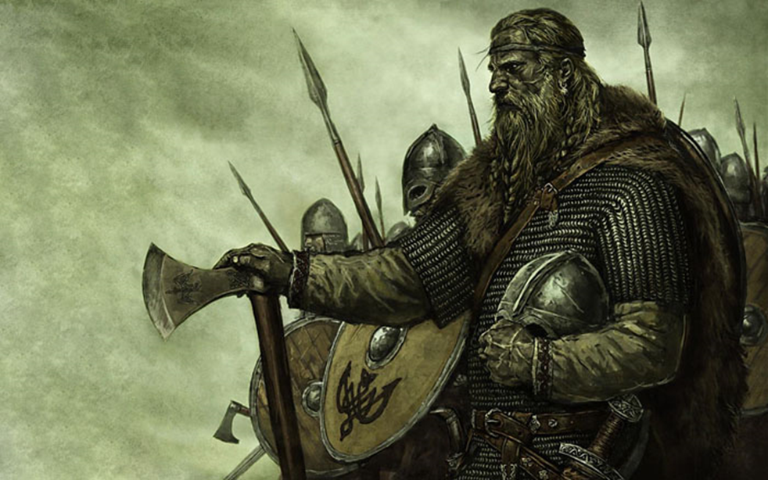
A Recipe for Disaster
The failure to designate an heir proved to be disastrous. The Witan acted very quickly after Edwards death and proclaimed Harold Godwinson king. His however was not the only claim to Edward’s crown.
There were in fact four claims to the English throne at that time.
Harold Godwinson
William of Normandy
Edgar the Aetheling
The fourth claimant was the King of Norway, Harald Hardrada, whose claim went back to before the reign of Edward the Confessor.
The death of Edward the Confessor and the fight for the right to his crown meant that 1066 was to end in turmoil.
Notes:
The death of Edward would not have come as a surprise. Harold would have been working behind the scenes for this moment for months if not years

Slide 12
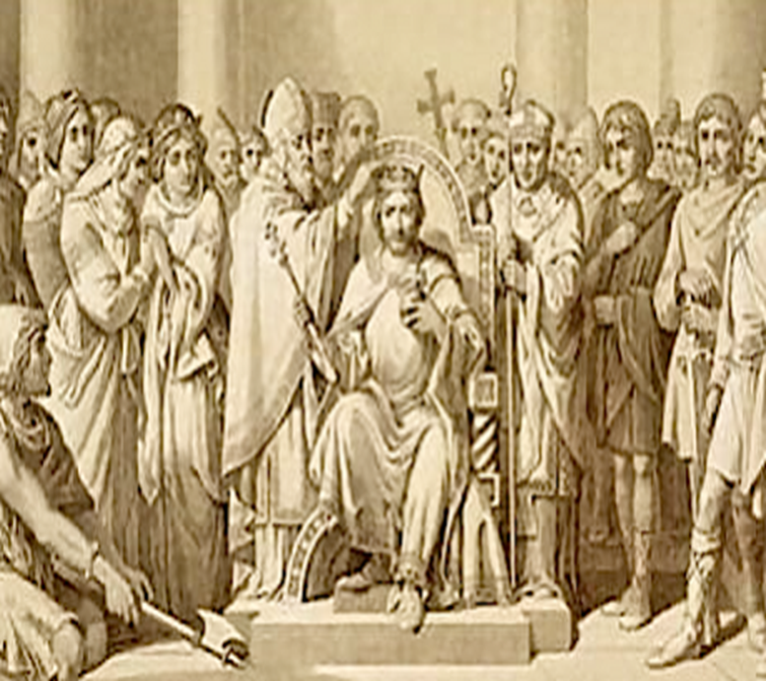
Question
But before we look at these men, what qualities do you think that they should possess in order to rule England well?
An experienced leader
Be a skilled warrior
Be English
Have the support of other nobles
Be related to the previous king
Using the Above examples along with your own ideas, discuss why you think these are important qualities to be King of England in 1066, then list them in order of importance in your worksheets

Slide 13
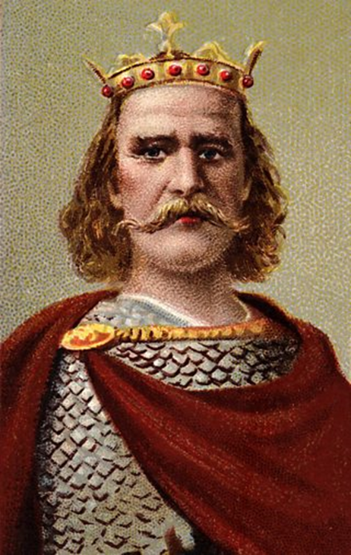
1066 Contender No.1
Harold Godwinson
Harold Godwinson was the most powerful nobleman in England at the time of Edward the Confessor’s death. As the king grew older, he grew weaker and much of the day to day running of the country would have fallen upon his shoulders. He was therefore the natural choice of the Witan.
He already had experience in governing England as a leading member of the Witan.
He claimed that Edward had promised him the throne on his deathbed.
He was an experienced soldier and had been in charge of Edwards Army
He had powerful allies in England
Notes:
Harold Godwinson’s claim to the English crown was not strongly based on any blood ties. Edward the confessor had married Harrold’s sister, Edith, which simply made Edward his brother in law.
He was however extremely powerful and experienced politically. He was probably the richest man in the country in 1066 and he and his family dominated the English ruling council, known as the Witan (fully called the Witangemot). It With such power and influence It is likely that he was the chief advisor to Edward the confessor and might even have taken most of the decisions relating to government in the last years of Edwards life.
The fact that he was an Anglo-Saxon noble would also have leant much to his cause. Edward the confessor had had very close ties with Normandy and was even thought to have offered the succession to Duke William. Such ties caused resentment amongst the English Nobility, who might have seen Harold as one of their own.
One major setback to his claim was, that after being shipwrecked off the coast of Normandy in 1064, he had fallen under the protection of William Duke of Normandy, who had supplied him with weapons and knighted him. In return Harold is said to have sworn, on Holy relics, that he would recognise William as King of England after the death of Edward the Confessor. Such an oath before God would have been taken very seriously in the 11th century.
Upon the death of Edward however, Harold claimed that William had tricked him into making the oath and he had not known that he was swearing on relics. The Witan supported his claim saying, that as he had been under the threat of his life, the oath carried no weight.

Slide 14
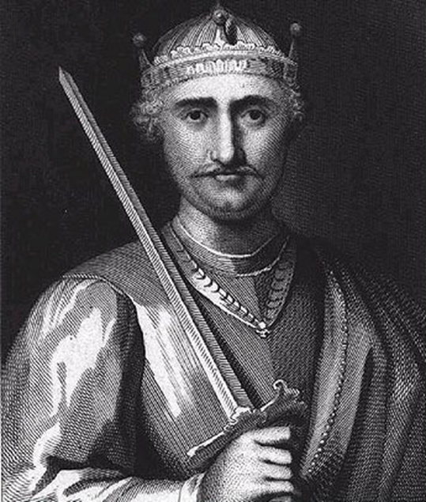
1066 Contender No. 2
William Duke of Normandy
William was a cousin of Edward the confessor
He claimed that Edward had promised him the English throne
As Duke of Normandy he had strong experience in governing a large area of land and its people
He said that Harold had sworn on holy relics to support his claim to the throne
The church and Pope supported his claim
Notes:
William might often be seen to the casual observer as a violent invader, intent on adding to his lands, his wealth, and his power. These things would certainly have been in his thoughts in 1066. But such ambition was not unusual for a powerful 11th century noble. What makes the difference in William’s case is his perceived right to take Military action. His claim, if true, was strong.
Normandy already had close ties with England, both political and economic dating back to the treaty of 988, signed as joint pact not to harbour the other’s enemies, namely the Vikings.
Normandy was Englands’ closest neighbour on the European mainland this made them natural trading partners.
Before becoming King, Edward the Confessor had spent over 25 years in exile mainly in Normandy, where he would have worked hard to make alliances and build his own power base, one of those alliances would certainly have been with Duke William.
On becoming King of England, Edward brought in advisors, nobles and priests from Normandy. This brought him into opposition with Godwin, the Earl of Essex; father to Harold Godwinson. As the man who had blinded and killed Edwards brother Alfred, we can imagine that there was little love loss or trust between the king and his Earl. When Godwin disobeyed an order from Edward to punish the people of over who had clashed with the Normans during the visit to England of Edward’s father in law, the Count of Boulogne. Godwin chose instead to side with the people of Dover against the King. Edward took this opportunity to deal with his overmighty Earl and, with the support of much of England’s nobility banished Godwin in 1051.
With this in mind, it is not difficult to imagine why Edward the Confessor might have looked beyond England’s shores for his successor, particularly one of Norman birth.
It is therefore possible that Williams claim that Edward had designated him heir is true. Were such a promise made it could have happened during Williams state visit to England in 1051. Surely he might have at least discussed the matter with his distant cousin, the powerful Duke of Normandy, who from the age of 8 when he became Earl after the death of his father, had himself successfully managed to solve the internal struggles that had threatened his own rule.
Whilst to modern minds we might take with a pinch of salt of Harold’s sacred promise to recognise William as king. We must however not underestimate the depth of religious belief at the time. The vow was made over religious relics before God. Such a vow would, to the medieval mind, have been unbreakable. This was certainly the view of the Pope who offered his support to Williams claim.
Harold himself did not dispute that he had made such a vow, only that he had been tricked and had not known that he was making it over religious relics. The witan who made Harold king, proclaimed that the vow was not valid because it had been made when Harold was in fear of his death as he had effectively been a prisoner of William at the time he made it.

Slide 15
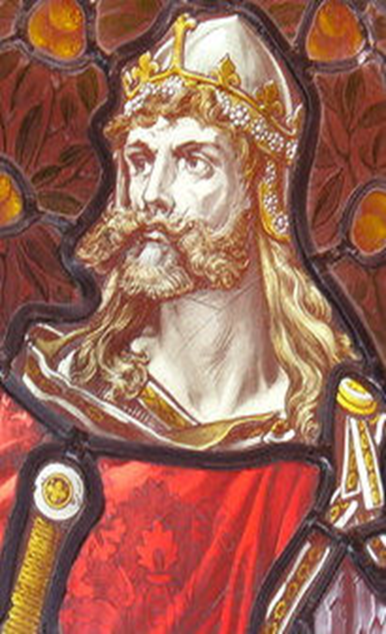
1066 Contender No.2
Harold Hardrada
Harold Hardrada was the grandson of Harthacnute, who had been king of England
He was King of Norway so already had experience of running a country
He was a strong and powerful Viking warrior
Notes:
In 1016 the Viking King Canute was crowned king of England. He was also King of Norway and Denmark. He ruled until 1035 and was succeeded by Canute’s’ son Harthacanute. King Harthacanute had no heir and promised the throne of England to King Magnus of Norway.
However, on the death of Harthacanute Magnus was old and weak and Edward the confessor seized the opportunity and, with the support of the English Witan, took the throne.
Harald Hardrada was the son of Magnus. His claim was strengthened when Tostig, the brother of Harold Godwinson pledged his allegiance to Hardrada and invited him to take the English throne.
In reality, the claim of Harald Hardrada was weak. He had no blood ties to Edward the Confessor or even to Harthacanute, the last Viking King of England. All he really had was a promise, which had been made to his father, Magnus.
Haralds ‘claim’ is most likely to be a grab for power at a time of perceived weakness. The Vikings had fought for over two centuries to bring England under their rule. Some Viking Kings had succeeded. Canute had been King of three countries and been known as Canute the Great. A Viking Warrior such as Harald Hardrada would have wanted to emulate such deeds.

Slide 16
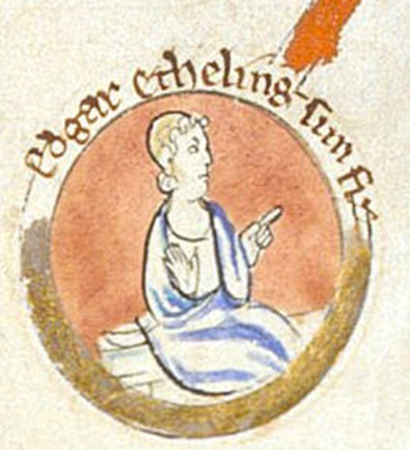
1066 Contender No.3
Edgar the Aetheling
Edgar the Aetheling was the great nephew of Edward the confessor.
He was the last surviving member of the house of Wessex who had ruled England for centuries
He had no army and was still a teenager upon the death of Edward
Notes:
Edgar the Atheling was the last Saxon prince of England, the word Atheling means prince. By later medieval standards his claim would have been pretty much undisputed. However, whilst Family ties to a former king did carry weight, it was in fact the Witan who decided on the next King. That said he would almost certainly been chosen over Harold Godwinson after the death of Edward the Confessor, were it not for his youth. He was 14 years old at the time and would not have been considered a viable choice at the time.
Historically the young age of an heir whilst difficult has not often been a cause to neglect him as a choice. William the Conqueror himself became Duke of Normandy at the age of 9.
The big problem for Edgar was the lack of support from England’s nobility. His Father, Edward of Wessex (often known as Edward the Exile) had been exiled to Hungry at the age of 2 some 35 years before Edgar’s birth in the same country. This meant that he had not opportunity to form the sort of inter family alliances that were common amongst the nobility during the middle ages.
Edward the Confessor, without a legitimate heir and seeking to settle the question of succession. Called Edward back to England in 1057. The Confessor fearing the possibility of Harold Godwinson’s rise to the throne would have looked to Edward of Wessex as a prince on the Royal House of Wessex. It is likely that his intention would have been to proclaim him as heir apparent. With such a title and with the support of the King alliances could have been forged and strengthened.
However, Edward of Wessex died only a few days after his arrival in England in mysterious circumstances. There have been suggestions that he was murdered at the hands of Harold Godwinson. However, it is likely that it would have been Harold who would have escorted Edward from Hungry and surely, if he had planned to kill him, would have done so far from England.
Whatever the circumstances of his death, it was one of the moments where the course of history might have changed. Had he lived the King would have proclaimed him heir apparent and with such a title and with the support of the King, Edward of Wessex would have gained the support of England’s nobility and the alliances he needed, the Witan would have proclaimed him King in 1066 and the Battle of Hastings might never have taken place.
The prospects of a 14-year-old boy, with a title but no political expertise, friends, or leadership skills were entirely different. The political reality in 1066 was that Edgar the Atheling did not have any chance to be King of England.

Slide 17
Victory For Harold Godwinson
On 6th January despite the strong claims of other contenders Harold Godwinson was crowned King of England.
Using what you have learnt today from your research and interviews, write a news article about this victory. Include the following.
Who chose him for king?
Why was his claim successful?
Does your newspaper consider this to be the right or wrong decision, give your reasons
What does the future hold? Does your paper believe that there may be consequences to this decision?

