Slide 1

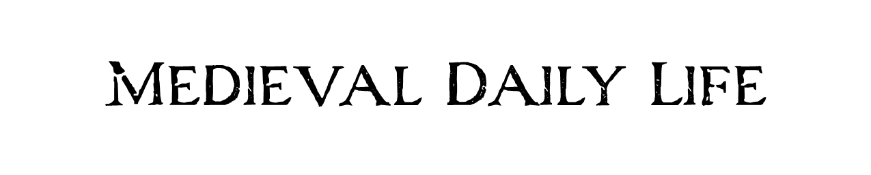
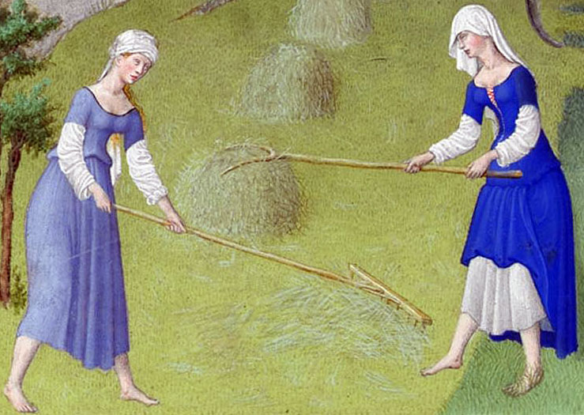

Slide 2
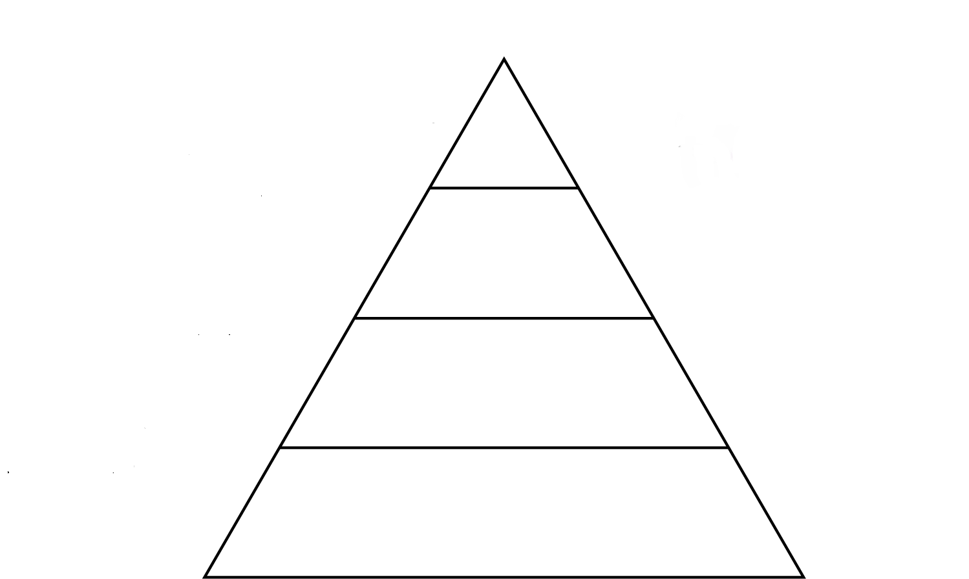
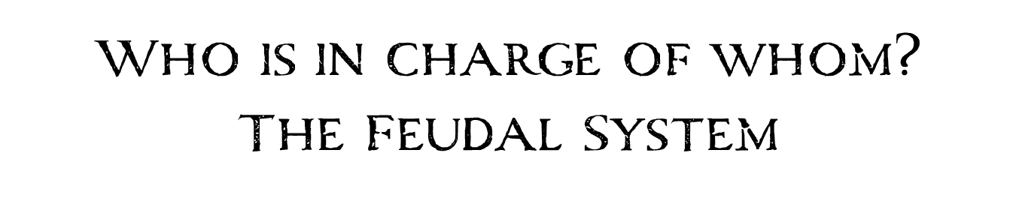
Notes:
The feudal system was the way that medieval society was structured and governed.

Slide 3

King
Notes:
In charge of the country and everyone in it was the Monarch otherwise known as the king or queen. He could not of course run the country on his own, so he divided up the country and gave some of the land to His Barons.

Slide 4

Barons supply knights and taxes to the monarch
King
Monarch gives land to Barons
Barons
Notes:
Beneath the monarch were the Barons and other high ranking nobles this included Bishops of the church. They ruled large areas of land called fiefs. They reported directly to the king and were very powerful. The Barons divided up their land among Lords who ran individual manors.
In exchange for the land and power handed to them by the king the Barons had to supply an army for the king to use should he need one. The promise to do this was known as homage. The Barons would also be responsible for raising taxes for the king.

Slide 5

Barons supply knights and taxes to the monarch
King
Monarch gives land to Barons
Barons
Knights fight in the Barons army
Barons give land to knights
Lords and Knights
Notes:
Lords and Knights – Lords and knights ran the local manors which were given to them by the Barons. In exchange the lords had to pay homage to the Barons and fight in his army for the king if required The lords owned everything on their land including the peasants, crops, livestock and villages

Slide 6

Barons supply knights and taxes to the monarch
King
Monarch gives land to Barons
Barons
Knights fight in the Barons army
Barons give land to knights
Lords and Knights
Peasants and serfs provide food and services
Lord gives protection to peasants
Peasants and Serfs
Notes:
Peasants and Serfs
Most of the people living in the Middle Ages were peasants. They had a hard and difficult life. Some peasants were considered free and could own their own businesses such as carpenters, or blacksmiths. Others were more like slaves. They owned nothing and were pledged to their local lord. They worked long days, 6 days a week, and often barely had enough food to survive

Slide 7
Facts about the feudal system
Around 90 percent of the people worked the land as peasants.
Peasants worked hard and died young. Most were dead before they reached 30 years old..
The kings believed they were given the right to rule by God. This was called "divine right".
The Lord held absolute power over the fief or manor including holding court and deciding punishments for crimes.

