Slide 1
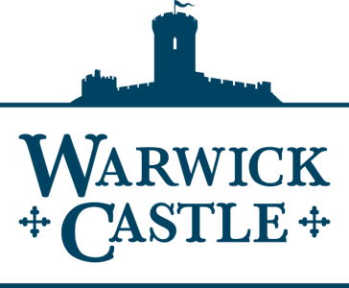
The Battle of Hastings

Slide 2
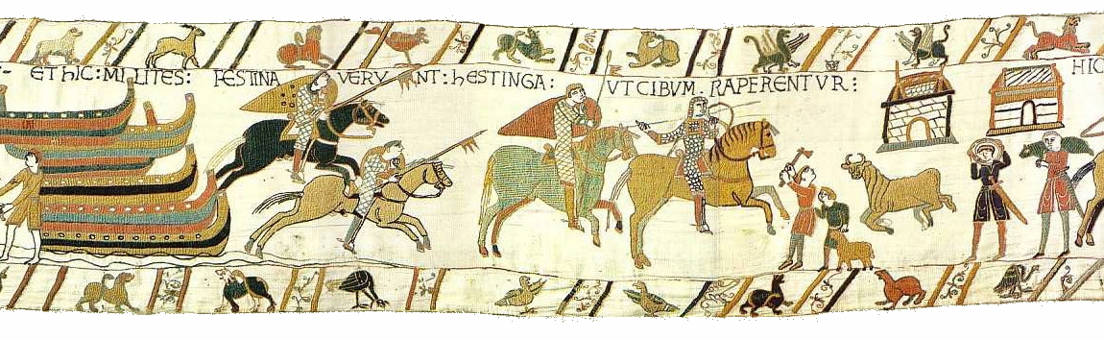
A Night To Remember
On the evening of the 13th October 1066 two opposing armies were camped within sight of each other. They had a night of rest before the battle that they knew must come the following morning.
At the head of the first army was Duke William II of Normandy. He had landed at Pevensey two weeks earlier, this had given him plenty of time to prepare his troops for the battle.
William would have been in good spirits on this night. As an invader in hostile territory he had needed to force this battle quickly, for fear that too long a wait meant he would run short of food, water and other supplies.
His opponent had obliged him by rushing south to meet him.
Notes:
The arrival of Harold was a Gift for William, as time was not on his side. His men and his fleet of some 700 ships had been ready for invasion by August 1066 and had waited at Dives sur Mer in Normandy for six weeks prior to finally setting sail.
Many historians believe that the delay was due to bad weather. It could also however have been that William knew of the invasion of Harald Hardrada and was waiting for the perfect moment to invade.
Whatever the reason each day that his army was on the wrong side of the channel meant that his supplies were diminishing. It also must be remembered that it was late in the season, winter was fast approaching and such a large force of men living so closely together risked disease, particularly dysentery. William needed this battle won quickly if he was to have any chance of winning the crown
He was probably short on supplies by the time he arrived in England and could not afford a further delay for battle. The image in the slide shows his men riding out to seize food after landing.
The text on the Bayeux tapestry, ET HIC MILITES FESTINAVERUNT HESTINGA UT CIBUM RAPERENTUR, translates as:
And here the knights have hurried to Hastings to seize food.

Slide 3
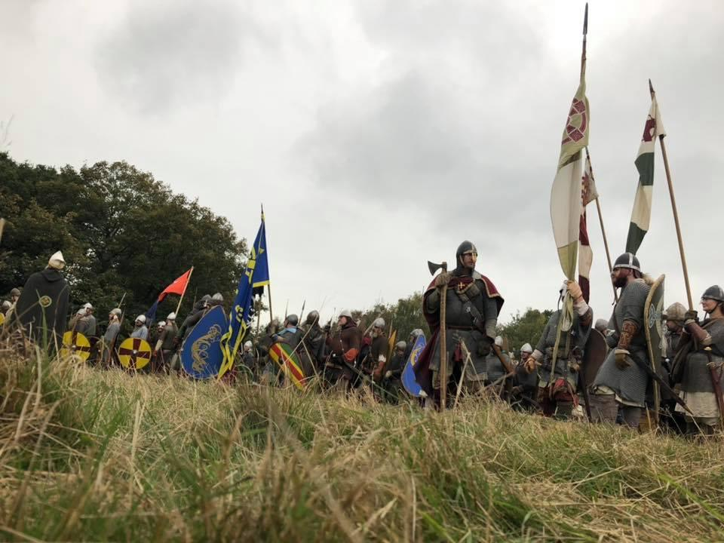
Why did Harold Choose to Fight.
Facing William and his Norman army, on nearby Senlac Hill was a Saxon army led by the newly crowned King of England, Harold Godwinson.
By contrast to William, Harold had not had the time to prepare. He and the core of his army had already fought and won a battle against the forces of his own brother Tostig and the Viking Harald Hardrada at Stamford Bridge only 20 days earlier.
These same men had then marched 220 miles to London where they collected reinforcements but rested only a few days, before marching again to Hastings to meet William.
Notes:
One of the mysteries of the Battle of Hasting was why King Harold rushed to meet William’s army. Time really was on Harold’s side. He could have simply waited and pinned the Normans with their backs to the sea as reinforcements arrived. Such a tactic would have starved the Norman army into submission and forced a humiliating withdrawal back to Normandy.
It is possible that, after the success of Stamford bridge where he had surprised the Viking army of Harold Hardrada and caught them unprepared for battle, Harold was simply trying the same surprise tactic again. If this was the case it certainly did not work as Williams advance scouts had given Duke William ample warning of the Saxon approach.

Slide 4
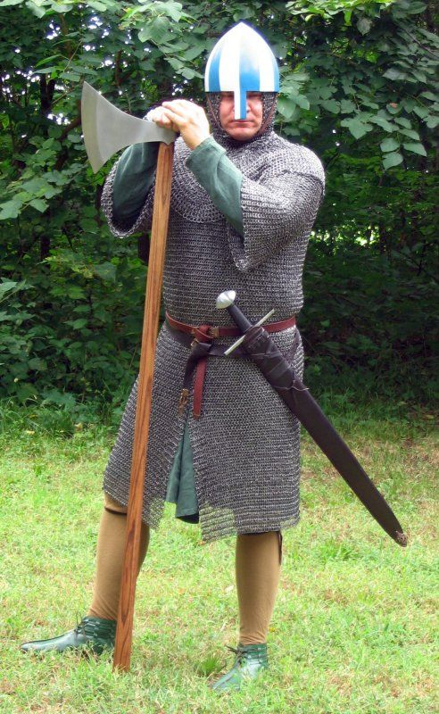
The Morning of Battle
The opposing armies were of a similar size, around 7,000 men. The Norman army were all professional soldiers and consisted of Archers, Infantry and Cavalry.
The Saxon army consisted of Housecarls, and the Fyrd.
The Housecarls were professional soldiers and fought with the king as his household guard. These men would have been armoured. They carried swords and the fearsome battle axe.
The Fyrd (pronounced fiad), were effectively a part time army of land owners and freemen, who the king could call upon to fight for him in time of need. Not all of the Fyrd would have been armoured, and they would have carried an assortment of weapons from spears to battle axes.
Notes:
There are many estimates as to the size of the armies at Hastings. Many modern historians suggest that the figure is between five and seven thousand. Given the length and closeness of the battle it is likely that both armies were of a similar size.
Williams army was probably the better trained and equipped and was made up of, not only Normans but also foreign mercenaries; Breton, French and Flemish. It is generally accepted that William’s mounted Knights were his elite and made up less that a third of his fighting force. The bulk of his army would have been infantry, armed with shields, swords and spears.
The Saxon Housecarls were the elite of Harold’s army and were professional soldiers, serving as the kings bodyguard. They were truly fearsome and battle hardened and would have been feared by William. At Hastings they stood in at least the first three lines of the shield wall. William would have known that if he could defeat the Housecarls he could win the battle. They rode to battle but always fought on foot and wore long mail shirts for protection known as Hauberks (pronounced Horber).
The Fyrd were effectively a part time army. In times of need the King would call on his Ealdormen, these were regional leaders, who would have had their own bodyguard, similar to the Housecarls. The Ealdormen would then call on the Thanes of their shires, (counties), these were local lords acting in the Ealdormans name. As with the Housecarls they would have rode to battle but fought on foot. The Thanes would have supplied their own equipment so their choice of armour and the weapons they carried would have depended on their wealth. There are scenes on the Bayeux Tapestry of some Saxons fighting only with wooden clubs. It must be remembered that these men were essentially farmers and in most years would never expect to be called upon. At Hastings the Fyrd would have been keen to get back to their farms and the remaining harvest in preparation for winter.

Slide 5
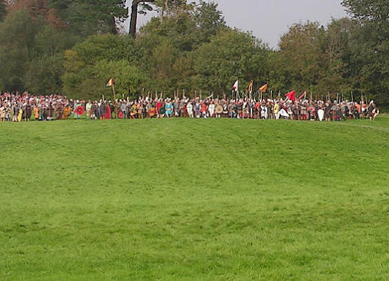
Lake of Blood
Harold had arrayed his troops on the top of a hill later known by the Normans as Senlac Hill.
Harold, possibly fearing the Norman Mounted Cavalry had chosen, not to fight on an open field, but to fight a defensive battle. He ordered a Shield Wall, where each man interlocked his shield with the men on his right and left. Such a wall, in so small a space was virtually impregnable.
The front 3 lines would have consisted of the heavily armoured Housecarls, with the Fyrd behind. So long as the Shield Wall held, victory should go to the Saxons
Notes:
The name Senlac hill was probably given by the Normans. It comes from the French word sang meaning blood and Lac meaning Lake. Lake of blood

Slide 6
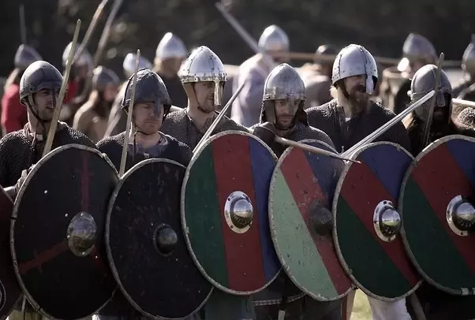
The Shield Wall
William’s task appeared simple. He knew that at least the front three rows of the Saxon shield wall would be filled with the highly trained and heavily armoured Housecarls. He would have to defeat them in order to break the wall.
This was easier said than done. Norman tactics on an open battlefield would normally be to attack using cavalry supported by archers and then to follow up with infantry.
William’s army relied heavily on cavalry. Of the 7,000 men in his army 2,000 were mounted knights. However, a well constructed shield wall was considered almost impervious to cavalry attack. The task at Hastings was doubly difficult as the mounted knights were attacking uphill. William also had around 1,000 archers who, unfortunately for him, were also hampered and would be shooting uphill.
Notes:
The shield wall constructed by the Saxons and their position on the crest of the hill, effectively nullified the key tactics used in traditional Norman battles, which would have been to attack with infantry, supported by armoured cavalry and archers.
Horses would shy away on facing a Shield Wall, exposing their flanks to the fearsome battle axes of the Housecarls.
Infantry would struggle to get through shields which were supported on either side of the section they might be attacking, whilst at the same time, infantry would be vulnerable to projectile weapons, axe strikes and thrusts from spears.
Archers, whose bows would normally have an effective range of around 100 metres, were hampered by having to loose their arrows uphill.
The Shield Wall itself would normally have itself been protected by a palisade of sharpened stakes, often with a ditch dug in front. However at Hastings it seems that Harold, who had been hoping to catch the Normans unawares, was himself surprised and had not had the time to make such preparations. That said his position was still extremely strong.

Slide 7
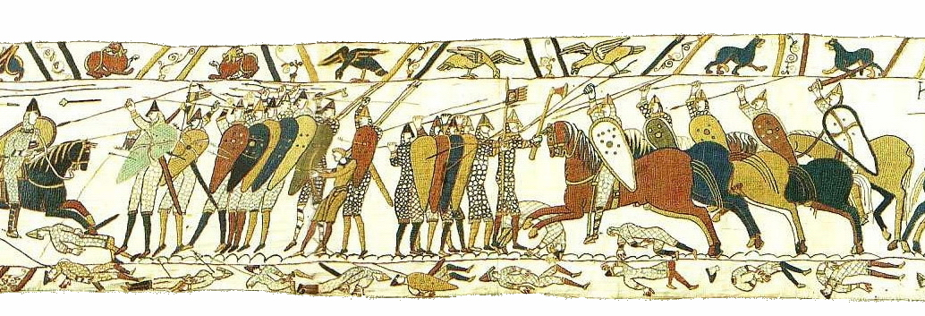
William Attacks
The Norman Infantry advanced first, climbing the hill in heavy armour. They were supported by archers and crossbow men who loosed volley after volley at the Saxon wall. But the wall held. Some men were unlucky and an arrow found its mark, but the bulk of this onslaught was absorbed by the shields of the Saxons and the shield wall held.
The Saxons stood firm and when the advancing Normans came into range they started to loose their throwing spears, aided by the downward slope these weapons along with rocks and hand axes began to take their toll on the attacking Normans.
The Norman infantry crashed into the Saxon wall, but still it held and more Normans fell. William sent in his cavalry but the highly trained Housecarls brought their two-handed battle axes into play and cut through mail, shields, helmets and horses. Men fell and the Normans began to falter.
Notes:
Whilst it is assumed that infantry would have formed the brunt of the initial attacks on the Saxon positions, the Bayeux tapestry shows no Norman foot soldiers at all, only Mounted Knights. Whilst much can be learnt by historians from studying the tapestry, the main authority for the events of the Battle of Hastings are taken from the writings of William William of Poitiers. He was probably not present at the battle itself but, as Duke Williams chaplain, he was a comrade in arms to many who fought and surely would have discussed the events. He would therefore have had a strong understanding of military matters.
You will find excerpts from the writings of William of Poitiers, along with other chroniclers, in the folder named sources.

Slide 8
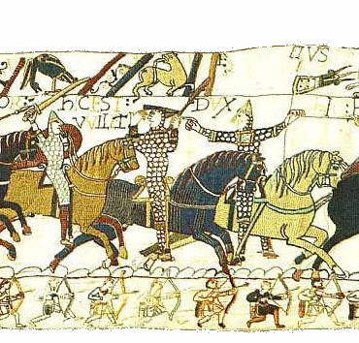
The Duke is Dead
Faced with the fury of the English defence, the Normans began to fall back and William’s battle line started to disintegrate.
The men on the left of line turned and ran. and the English came forward, ripping into the Normans.
Saxon victory was close. Amid the chaos of this near rout the cry went up that Duke William had been killed and panic set in. Standing in his saddle and pulling off his helmet so that his men could be seen he shouted
“Look at me! I am living and with God’s help I shall be victor! What madness leads you to flight? What retreat do you have if you flee? If you keep going not a single one of you will escape.”
Notes:
This is a key point in the battle and one which is well known. William pulling off his helmet and rallying his troops is shown on the Bayeux tapestry and his rallying cry was recorded by William of Poitiers. Whether this event is literally true or an exaggeration of Norman propaganda, it certainly seems to have been a turning point in the battle. Enough sources agree and suggest that at this point in the battle the Saxons certainly had the upper hand. So it is logical to believe that William would have needed to show his own personal bravery and exhibited strong leadership else lose the battle.

Slide 9
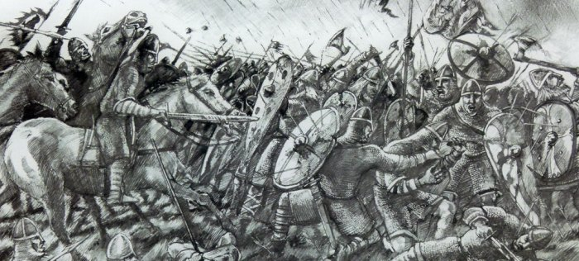
The Normans Rally
The Duke’s bravery at this moment was a turning point. His army, facing defeat and despair only a few moments earlier, rallied to their leader. This was a disaster for the pursuing Saxons.
With his men now steadied, William turned them loose on the pursuing Saxons. The Normans stormed into the Saxon left, who for an unknown reason, had abandoned the security of the hill’s ridge.
Cut off from the rest of their army, stranded on open ground and having lost the protection of the shield wall, the Saxon left flank was doomed.
Notes:
It seems likely that it was the inexperience Fyrd who broke discipline and pursued the fleeing Normans. Harold’s orders at the start of the battle would have been extremely clear.
“Stand firm.”
He would have known that any break in the shield wall could be disastrous for his army.
But faced with the horror of what was for many their first pitched battle, the Fyrd must have believed that the Norman rout was an opportunity to get the battle over quickly

Slide 10
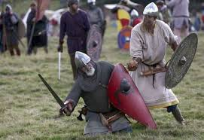
Stalemate
We can only imagine the effect on the morale of the Saxon soldiers watching from the top of the hill. Barely moments ago they had been on the brink of victory, but now had to stand and watch as hundreds of their comrades were slaughtered only a short distance away.
After six hours of fighting the men on both sides were bloody and exhausted. The Normans had been repulsed, but so too had the Saxon counter attack. Hundreds were dead on both sides. This battle had reached stalemate.
The Saxons, however had time on their side. William had to win this battle today for fear of English reinforcements.
Notes:
William must have been acutely aware that he must finish this battle before nightfall. Should he fail then the Saxons would almost certainly withdraw and await reinforcements. William, who we know had sent out scouts before the battle who had warned him of Harold’s advance, was probably aware That the Northern Earls Morcar and Edwin were marching towards Hastings at this very moment.

Slide 11
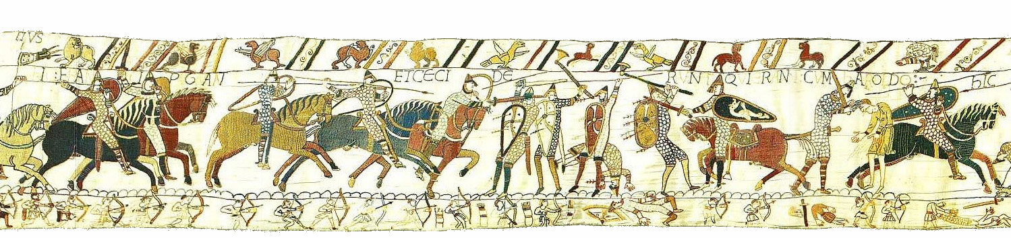
A Battle of Attrition
William tried a new tactic. His army was already split into three divisions, so he ordered all three to make repeated attacks on the Saxon line.
Cavalry from one division would attack a portion of the Saxon shield wall. They would then withdraw and in would come the heavy infantry. Then it would be the turn of the second division, and then the third. Cavalry, infantry, cavalry, infantry, and so on.
Each attack was supported by archers and crossbowmen from all three divisions In this way, William intended to grind down the Saxons. His divisions could make their attacks and have time to rest in between, whilst the defending Saxons had no such luxury.
Notes:
Prior to the battle, William had split his army into three divisions, or battles. The Normans under William himself took the centre with the French on the right commanded by William fitzOsbern and Count Eustace II of Boulogne. The division on the left were Breton, commanded by Alan Rufus. It is interesting to note that whilst we think of the Battle of Hastings was a fight between Normans and Saxons, Only a third of the Norman army were actually from Normandy. With the rest being effectively mercenaries fighting for the promise of land, titles and wealth should they be victorious.

Slide 12
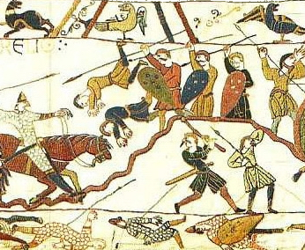
The Tide Begins to Turn
The battle raged on and slowly the tide began to turn in the Norman’s favour, as one by one the fearsome Housecarls began to fall. Defeat for the Saxons was becoming inevitable. The only thing that might save them would be nightfall.
Both William and Harold knew this. The coming of night would allow the Saxons to withdraw and await the reinforcement. Should this happen then all of the Norman achievements of the day would have been to nothing.
William’s tactics however were beginning to work. Cracks began to appear in the once solid armoured wall as Housecarls fell and were replaced by the unarmoured Fyrd.

Slide 13
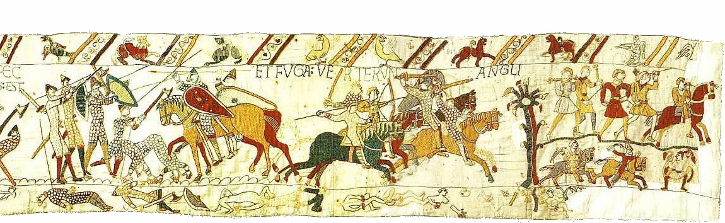
Trick Tactics
Seeing that the wall was weakening, William ordered his cavalry to begin to make feint attacks. They would make what appeared to be half-hearted attacks on the Saxon line and then would fall back in seeming disarray. This was a tactic that the Normans had already used in battles in France.
The less well disciplined Fyrd on seeing the apparent flight of the Normans gave chase in the hope of destroying their opponents once and for all. Only to see the Normans turn around and surround them.
Cut off from their comrades and the protection of the shield wall, the Fyrd had no chance and were quickly killed.
The Normans tried this ruse twice more and hundreds more Saxons fell.
Notes:
Once again it is the Fyrd, whose lack of discipline causes the damage. However we should remember that a battle was a relatively rare event at this time in history as it could prove so costly. Some of the Fyrd may have had some battle experience, those who had fought at Stamford Bridge for example. But even these men would not had the disciplined of the Ealdormen bodyguard or the Kings Housecarls, but they had seen these great men fall all the same. That the Fryd showed great courage at the battle is clear and was even celebrated by the Norman commentators at the time.
However the Fryd were time soldiers, who had fought throughout the day, they were tired and hurting and would by this stage would ave surely grasped at anything that might bring the battle to an end.

Slide 14
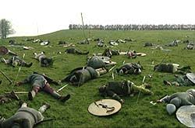
The End is in Sight
Once again William changed tactics. The rolling attacks from his three divisions and the feint attacks from his cavalry had brought him this far, but the Saxon shield wall though noticeably smaller was still holding after six hours of ferocious fighting.
William now ordered his men to attack on mass, crashing into the Saxons in an effort to force a break in the shield wall. The light was beginning to fade but it was too late for the defenders. The shield wall disintegrated and became a number of smaller shield rings as the desperate Saxons fought on to protect their lords and king.
The battle was lost for the Saxons, but the war was not over. If King Harold survived, then Anglo-Saxon England would still have a king, who would serve as a rallying point for the defence of England.
Notes:
Time and again during the Battle of Hastings William showed his qualities of leadership. He had been faced with an almost impossible task at the beginning of the day. A Saxon army led by a King who had already defeated a ferocious Viking army, stood on top of a hill in the much vaunted Shield Wall tactic, which would force Williams army to tire themselves in repeated attacks. William had to win on this day as reinforcements of the morrow would destroy any chance of his taking the English crown. He had a little luck, the actions of the English Fyrd must have helped in his victory. But it was his courage and the flexibility of his tactics which finally won the day.

Slide 15
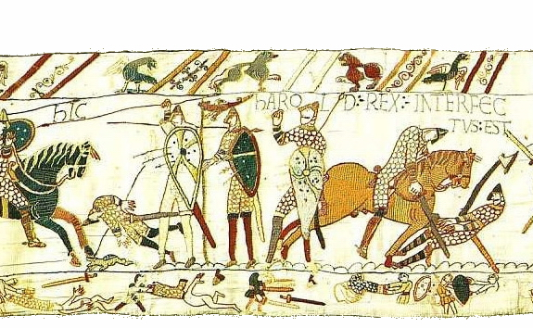
The Birth of Norman England
Had Harold survived the battle of Hastings, it is possible and even likely that the battle would have been a footnote in English history, seen only as a setback for Harold and the Saxons.
But Harold did die at Hastings. He was cut down and killed, alongside his brothers, the Earls Leofwine and Gyrth. His death put an end to Saxon resistance and William ordered his cavalry to pursue and cut down the remaining fleeing Saxons.
The Battle of Hastings paved the way for William to be crowned and was the beginning of over 200 years of Norman domination.
Notes:
That William was the better General on the day is without doubt but questions still remain as to how the Norman conquest of England, which began in 1066, ever even got off the ground.
Why did Harold even fight this battle? He didn’t have to, he could have trapped William at Hastings, awaited reinforcements and starved him out.
Why in the first Norman rout did Harold do nothing? Had Harold ordered his men to advance at this moment, surely then the Normans would have kept on running. They had thrown their best at the Saxon Shield Wall without even denting it, had it started to advance on the fleeing Normans then no courageous rallying cry from William would have had a hope of stopping his men from running back to their ships.
And finally why did Harold stay? He could have slipped away protected by his bodyguard. He would have lost the battle but kept his crown and lived to fight another day.
Yes Williams good leadership won the battle. But it equally argued that Harold’s poor decisions and seemingly total lack of leadership lost the battle for him and England.

