Slide 1

1069
The Harrying of the North

Slide 2
Curriculum Links
Develop a chronologically secure knowledge and understanding of British history.
understand how our knowledge of the past is constructed from a range of sources.
Develop the appropriate use of historical terms.
construct informed responses that involve thoughtful selection and organisation of relevant historical information.
Learning Goals
At the end of the lesson students will:
Have an understanding of the events leading up to, during and after the Harrying of the North.
Have an understanding of the cause and effect of these events.
Have been introduced to the possible reasoning behind some of William’s decisions.
Have been introduced to key source writers, notably Orderic Vitalis.

Slide 3
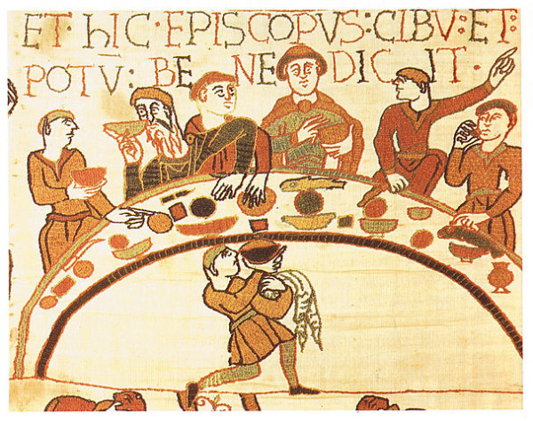
Christmas Day 1069
York
We can only imagine what William the Conqueror ate whilst he celebrated Christmas in York in 1069.
His banquets would almost certainly have included Boar venison, partridge, beef bread cheese and wine.
Christmas then, as now, was a great time of feasting.
Notes:
There are no references to Christmas food until the late 13th century. The examples given in. This slide come from the records of Richard de Swinfield, Bishop of Hereford. Archeological evidence of bones, cooking utentsil etc does however tell us the types of food that an 11th century Norman lord would have eaten.
The good Bishop's menu also included geese. The inclusion of rabbit is due to the known Norman passion for rabbit, which was a luxury item. And as such is likely to have been brought out at Christmas

Slide 4
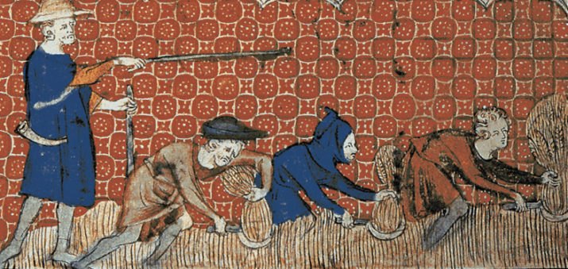
Christmas Day 1069
Northumbria
Whilst we can only imagine what William was eating for Christmas lunch in York, we can speak with some certainty about what was being eaten further North
If they were lucky they would have had a cat or dog or might have been able be able to find a rat or two
There was very little choice. To do otherwise was to join the folk of the North of England who were slowly starving to death.
Notes:
We do know that William ordered his crown and regalia to be brought from Winchester to York. William had come North to fight but now wanted to celebrate Christmas as King. However he would have been surrounded by reminders of the events which had brought him north for Christmas. York Cathedral was partly ruined due to the ravages and destruction brought upon the city by rebel Saxons.

Slide 5
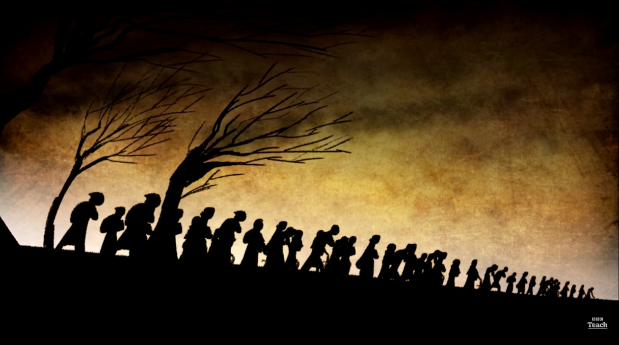
The Beginnings of Famine
The famine began upon the orders of William 1st, given only a few weeks earlier. He had split his army into units and sent them north to kill the inhabitants and destroy everything that was capable of sustaining life.
They burned barns stocked with grain for the winter, they killed animals in the fields and cats and dogs. The Norman army destroyed anything and everything that could possibly be eaten.
When all was waste, the soldiers added salt to the fields.
The result of all of this destruction was tens of thousands of deaths as the North of England starved.
Notes:
Many contemporary historians commented on the detail of the harrying including the 12th Century Norman historian Orderic Vitalis, who gave a description of the systematic nature of the destruction
'The King stopped at nothing to hunt his enemies. He cut down many people and destroyed homes and land. Nowhere else had he shown such cruelty. This made a real change. To his shame, William made no effort to control his fury, punishing the innocent with the guilty. He ordered that crops and herds, tools and food be burned to ashes. More than 100,000 people perished of starvation.
I have often praised William in this book, but I can say nothing good about this brutal slaughter. God will punish him’
There are accounts that salt was added to the fields. If this is true then it would have been a symbolic gesture of purification. Salt was an expensive commodity and to cover such an area would have taken tens of thousands of tonnes

Slide 6
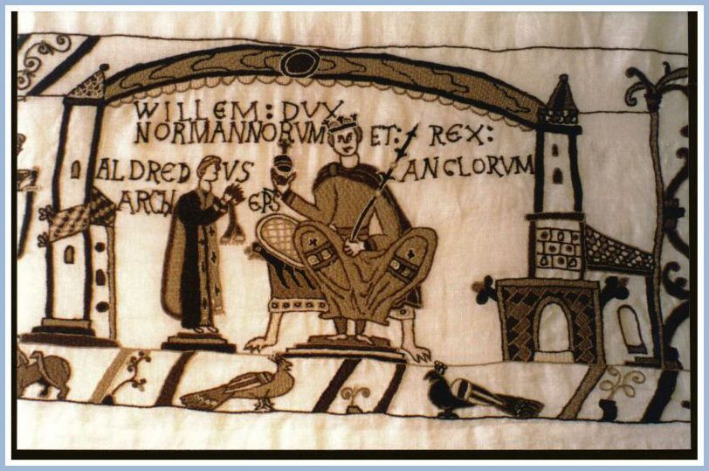
Three Years Earlier
Christmas day 1066 was not celebrated in the partly ruined Cathedral at York, but in the splendour of Edward the Confessor’s recently completed St Peters Abbey (now known as Westminster Abbey).
This day was also the day of William’s coronation, which he would have seen as the beginning of the consolidation of his newly won Kingdom.
By choosing the Abbey, which was so closely associated with Edward the Confessor, William was saying that he was the next rightful King. And was here to stay.
Notes:
Christmas day might seem an odd date for such a ceremony. William had made great gains in the ten weeks following Hastings. After the battle his main objectives would have been to take London and win the allegience of the Southern Saxon nobility. What better way to claim such allegience than through the sacred ceremony of coronation. William believed that his right to the English throne was God given. But he also would have seen his coronation as a message of confirmation that he was here to stay and that God was on his side.
The completion of St Peters Abbey had been the pet project of Edward the confessor, he had died a few days after its consecration and was buried there on 6th January 1066. By recieving the crown in the same place and in the same year William was placing himself in the due line of succesion. He underlined this by having Aldred, Archbishop of York, preside over a ceremony, spoken in English, using liturgy and traditions that had been used to crown Saxon Kings for over 100 years.

Slide 7
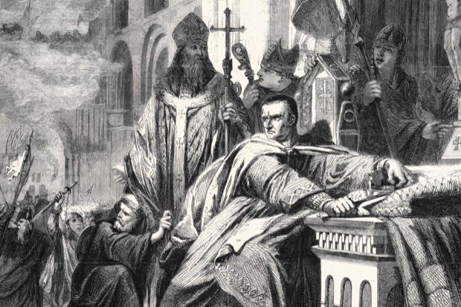
Christmas Mayhem
Many of the elements that were used in Williams ceremony are still used today. One such element is the Swearing of Loyalty by the nobles present.
When this moment arrived in William’s coronation and the French Bishop asked if they accepted William as their new monarch, the lords both Saxon and Norman, shouted their assent.
Norman guards stationed outside the cathedral mistook these shouts for cries of defiance and betrayal and acted without thinking or verifying. They set fire to buildings surrounding the Abbey, before carrying their mayhem into the Cathedral itself.
Notes:
By ordering that his coronation should be presided over by both the English priest Aldred, Archbishop of York, and Geoffrey, the French Bishop of Coutances, William was claiming his right to the throne under God and English law; whilst at the same time, proclaiming the new order
The French section contained a section called the Laudes Regiae’ or royal praises; which had first been sung at the coronation of Charlemagne.
A section of the Laudes Regiae contained a Norman tradition where all present were asked if they accepted their new monarch as their ruler and must shout their assent. This would have been an important moment for William as the congregation contained all of the subjugated southern Lords, including Edgar the Aetheling, who had finally bent the knee to William upon his entry into London.

Slide 8
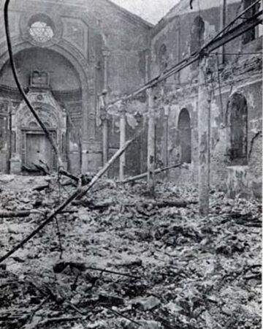
Saxon Resistance
Not with the majesty and solemnity that he would have preferred but William, was all the same, crowned King.
The soldiers reaction seems ill considered to us today, but we must remember that William’s army was on high alert. They had fought hard for 10 weeks to get this far, but they knew that they would have to keep on fighting and would meet resistance and rebellion for a long time to come.
Throughout 1067 William had to deal with uprisings in the south and the Midlands. William’s forces, upon defeating each uprising, constructed castles from which a Norman garrison could control large areas of land
Notes:
Traditional history tells us that during the mayhem of his coronation William could be found cowering inside Westminster Abbey. This can be sourced to the writings of Orderic Vitalis who wrote: Only the bishop and a few clergy and monks remained, … and with difficulty completed the consecration of the king who was trembling from head to foot.
It seems unlikely however that the man, who had wrestled for and won control of Normandy and was on the verge of doing the same in England, would be scared by the actions of his own soldiers. It is far more likely that this man of action would have actively sort to control the situation.

Slide 9
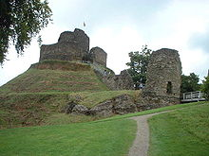
The North Rises
The might and power of the Motte and Bailey castles in the South and the Midlands mean that these areas of the country were largely subdued.
Things were different in the North. With only two castles in York, Norman power did not extend in the way that it did further south.
At the beginning of 1069 the foreign born mercenary Robert Cummin was installed by William as the new Earl of Northumbria. The Northumbrian response was to slaughter Robert and his army In Durham. Once again William and his army were forced to march to meet this threat.
Notes:
Even under Saxon rule the power of the crown was diminished compared to that of the south of England. England had only been a unified country for less than 140 years. Much of the old emnities and mistrust between the old kingdoms still existed in the North.
William's initial attempt to bring the North to heel by appointing English Earls to govern them failed. The first, Copsig, was killed by a rival and the second Gospatric later defected to the Northern rebels.
William needed to bring the North under Norman control. And chose a Norman ally in Robert Cummin

Slide 10
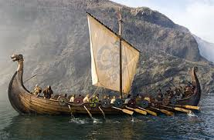
Unlikely Allies
In the summer of the same year William found himself facing the biggest threat to his rule to date, when a Viking invasion force, sponsored by King Swein of Denmark landed on England’s northern shores.
The Vikings found willing allies in the lords of the north. They joined forces and marched on York. One of the leaders of the Saxon army was Edgar the Aetheling who had been declared King of the Saxons on the day following the Death of Harold at Hastings.
Together the combined Saxon and Viking armies seized the city of York, destroyed it’s castles and put the surviving Norman garrison to death.
Notes:
It might seem strange, given the historical reputation of the vikings that the Northern rebels chose to ally themselves with the Danish invasion force. The rebels would certainly have been glad of the extra warriors and the Vikings were a known foe. There had already been 4 Viking kings of England.
It might seem strange, given the historical reputation of the vikings that the Northern rebels chose to ally themselves with the Danish invasion force. The rebels would certainly have been glad of the extra warriors and the Vikings were a known foe. There had already been 4 Viking kings of England.

Slide 11
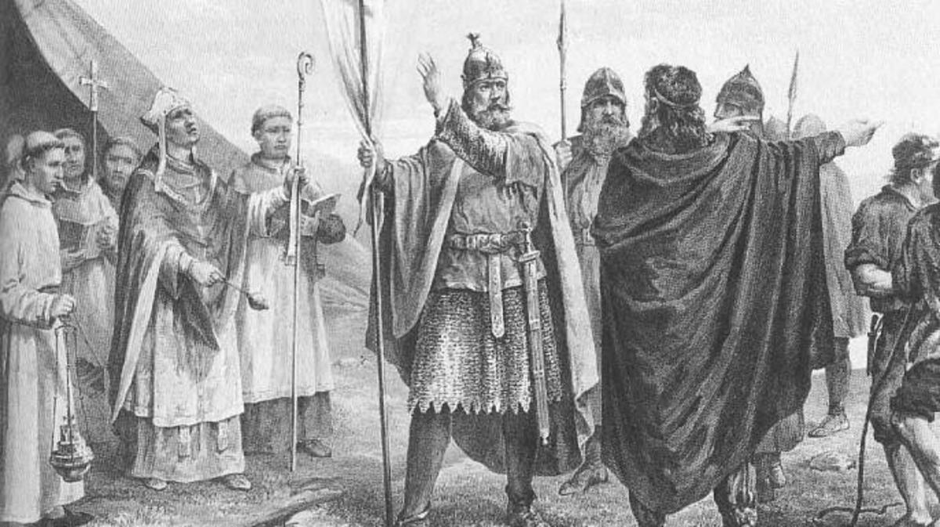
A Clever Plan
William raced North to meet this threat to his rule, but on arriving at York was frustrated to discover that the Vikings and the Saxon rebels, warned of his arrival, had already left the city. He must have begun to worry that the conquest was beginning to fail, so he came up with a clever two-fold plan
He first secretly approached the Vikings who were berthed on the river Humber, and offered them a vast quantity of gold and silver if they would leave by spring.
He then split his army and sent them North, to begin what was to become not only one of the most vicious and violent periods of the Norman conquest, but of the whole of English history.

Slide 12
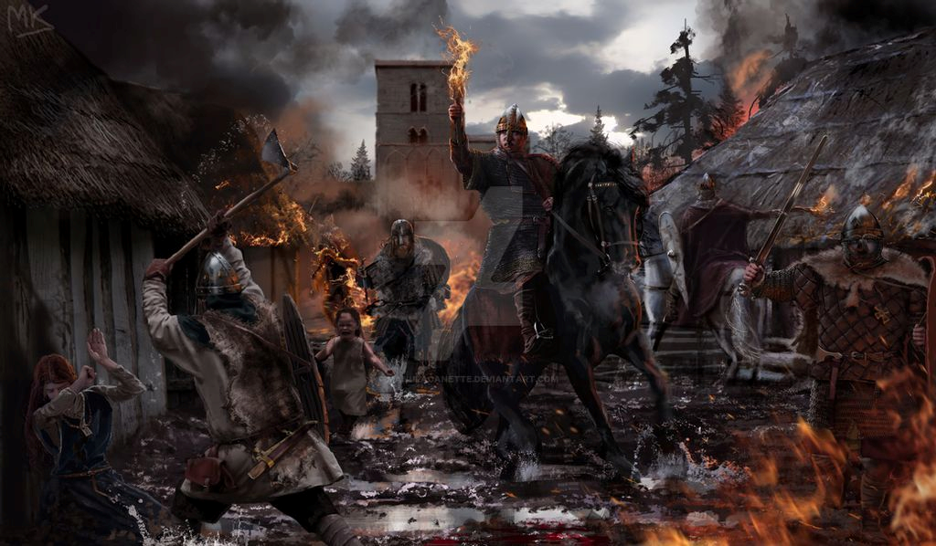
The Harrying Begins
The Norman army was highly efficient. They spread out over 100 miles of territory as far North as the river Tyne. They had two simple objectives. Orders given to them by William without mercy.
The first was to find and eliminate the remaining northern rebels. Whilst they did not succeed in capturing Edgar the Aetheling, who fled to Scotland, he was never again to prove a threat to the conquest and finally submitted to William’s rule in 1074
The second objective, was to destroy the region’s food and resources so comprehensively, that it would put an end to the cycle of rebellion by ensuring that any future Saxon resistance or uprising would not have the means to support itself.
Notes:
The ruthless efficiency of the Norman units during the Harrying has done much to colour the view we have of the Normans as mercilous warrior class, who ruled the country with an iron fist.
At this moment in history, however, this must have been exactly what the men carrying out the harrying were. They were professional soldiers, who had been on active duty for 3 years. They had seen and done so much, that they were immune to the slaughter. They were tired vicious men, let off the leash with the orders: "End It Now!"

Slide 13
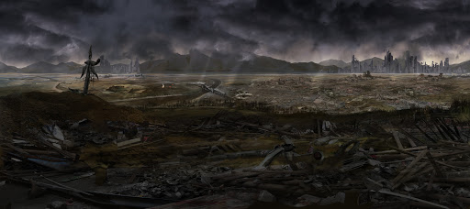
The Aftermath
Vicious and merciless as it was, the Harrying was certainly efficient and effective. One English Monk, the chronicler, John of Worcester, wrote in the 12 century that, in the aftermath of the Harrying, the surviving inhabitants were reduced to not only eating their horses, cats and dogs but also human flesh in a effort to survive.
The writer Symeon of Durham claimed that not one village between York and Durham remained inhabited and that much of the north was wasteland for the next 9 years.
According to the Domesday book, which was a census and survey of England; ordered by William and published in 1086, one third of all the available land in Yorkshire was recorded as vasta (waste).
Notes:
According to the Domesday book 80 percent of all the vasta (waste) in the whole of England was in the North.

Slide 14
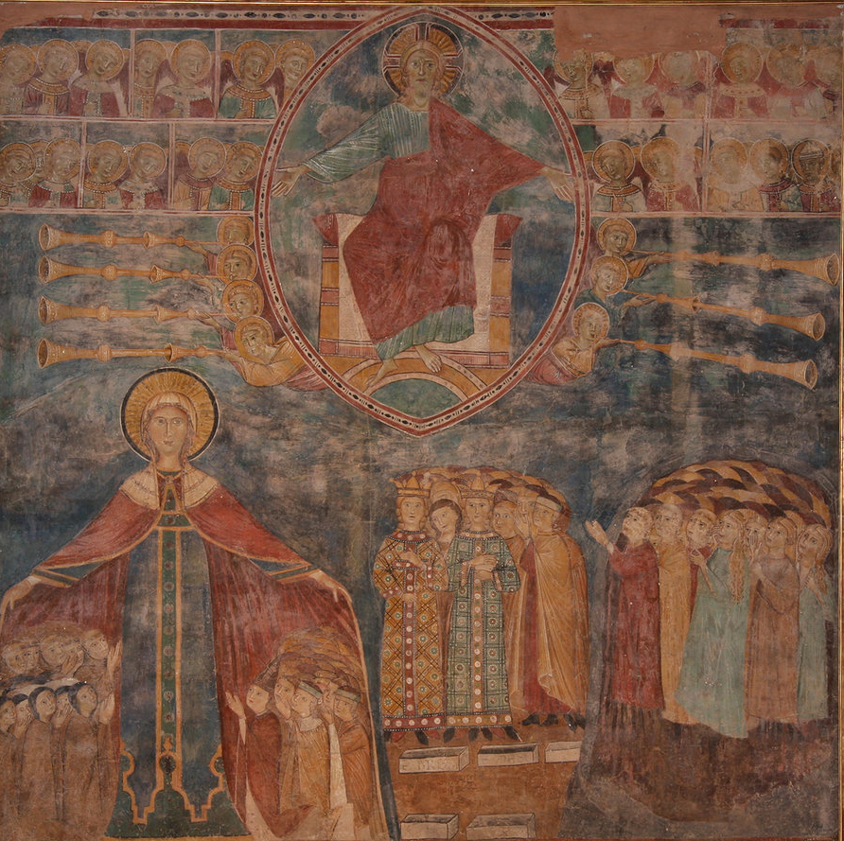
How Should William Be Judged?
By modern standards it is impossible not to consider that the Harrying of the North was a war crime.
Even by standards of the day, such a campaign of deliberate destruction and death must have been hard to imagine or understand
The Norman historian Orderic Vitalis who rarely criticised the Conqueror and believed that William had the God given right to sit on the English throne stated
More than 100,000 people perished of starvation.
I have often praised William in this book, but I can say nothing good about this brutal slaughter. God will punish him!
Notes:
Whilst Orderic Vitalis's figure of 100 000 deaths might appear, on the face of it, a little convenient and might just signify a very large number, a glance at other contemporary sources, including the domesday book, suggests that a figure into the tens of thousands is certainly reasonable. This should be taken in the light of an estimated total population at the time of arounds Two million.

Slide 15
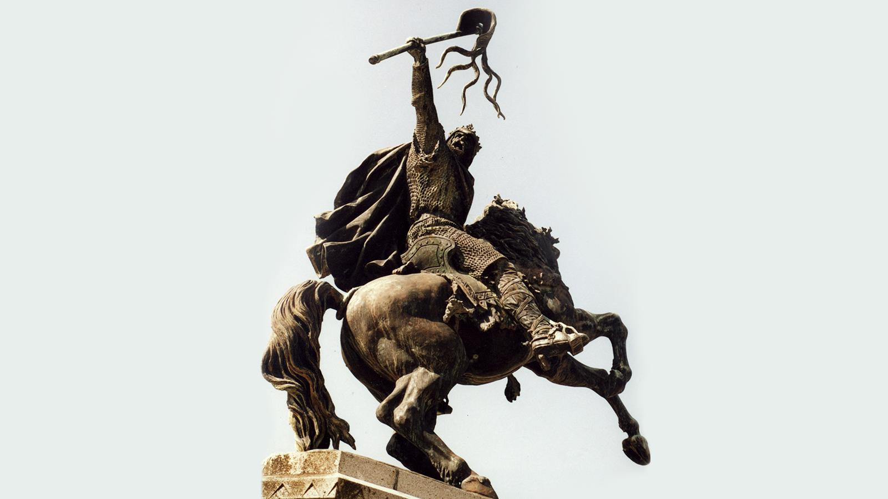
Here to Stay
Appalling though it was, by any standards, the Harrying of the North was certainly effective.
Many Saxons after Hastings may have believed that there was still Saxon light at the end of the tunnel. But in the aftermath of the Harrying of the North such light was extinguished
In his virtual destruction of the North, William had also destroyed the hopes of any who still believed that the result at Hastings could be overturned
The Conqueror was here to stay.
Notes:
William did have to deal with further uprisings after 1069, notably one known as the revolt of the three Earls in1075. This quickly failed for lack of support and organisation and was the last serious threat to William's rule.
After 1075 the consolidation of conquest was largely completed.

